Slide 1

Vehicle Pre-booking Optimization
Department of Chemical Engineering
IIT Guwahati
Under the Guidance of Dr. Prakash Kotecha
Submitted By – Rishant Pal ,Jashwanth and Bajendra

Slide 2
Introduction
Millions of people commute by car every day; for example, to school or to their workplace. self-driving vehicles are an exciting development for transportation. they aim to make traveling by car safer and more available while also saving commuters time. Therefore, the necessity of studying the effectiveness and result of this automated pre-booking of rides is existential.
Link to video presentation

Slide 3


What to solve! Our own.
Given a list of pre-booked rides in a simulated city and fleet of self-driving vehicles, optimally assign all the pre-booked rides to vehicles.
Note
We do assign bonuses for in time drop.
And a penalty for late rides.

Slide 4
4. Problem description
The following are the definitions you would want to know
Map R X C grid with 0-based indexing
Vehicles There are V vehicles to help you out
Time and distance Remember the old school Manhattan distance ? |a − x| + |b − y|

Slide 5
4. Problem description cntd..
Rides N pre-booked rides that you have to optimize
Bonus A bonus of B would be awarded for in time dropping.
Scoring on time -> just the fare in time -> bonus late -> penalty

Slide 6
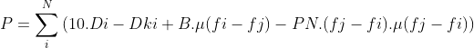
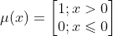
Equations
D_{ki} = excess distance to be covered before starting ith ride x (1 point per distance covered)
f_{j} = finish time for jth allocated vehicle in ith ride
= start time of jth vehicle + total time taken for the ride
B = bonus value
PN = penalty value

Slide 7
Decision variables
Our problem has 2*N numbers of decision variables where N represents the number of rides.
In those variables, the first N number of variables represent the ride start-time and last N number of variables represent the vehicle allotted to the ride.
Start-time has the lower bound of start time given in the data and upper bound of infinite.
Vehicle is in the range [1,M] where M represents total number of available vehicles.
All our decision variables are Integers.

Slide 8
Constraints
If the start time for a ride is taken as S then S : s_{i} ≤ S ≤ f_{i}-min(dur_{i,mj})
There should not be 2 rides i,j such that m_{i} = m_{j} and S_{i} ≤ S_{j} but S_{i} + dur_{i,mj} > S_{j}
A ride should be completed continuously
We use a metaheuristic technique and apply the fitness function f as objective function to be minimized.

Slide 9
Genetic Algorithm
Genetic algorithm is a type of metaheuristic technique which is widely used for optimization problems. From a set of randomly generated population pool, new solutions are generated through selection of good solutions from parent set and they are crossed over and mutated.
The best solution are chosen from These newly generated solutions. In this way via multiple iterations the genetic algorithm tends to an optimal solution.
For solving our optimization problem we used the inbuilt GA function available in MATLAB with our custom generation and iteration values.

Slide 10
Algorithm flow
Fitness = fit(d) //d = concatenation of si and mi
Lower bound of d(lb) = [start-time repelem([1],N)]
Upper bound of d(ub) = [inf(1,N) repelem([M],N)]
Define the options for ga plot generation
[x,fval,~] = ga(fitness, 2*N, [], [], [], [],lb, ub, [], intcon, options)
The final profit made by the rides is -fval(the output)
Function fit(d): //calculation of objective function
Importing the data set containing given values.
We sort d based on ascending order of start time value
For i = 1 : N
Calculate excess distance to go before next ride for each vehicle(dki)
Calculate the absolute distance for the ride
Saving coordinates of the vehicles position after completing each ride
Calculate the total profit value as described in the objective function with B = 20, PN = 100
For any overlap of rides at any particular time for one vehicle we add a penalty of 1000
Return : fitness = -P

Slide 11
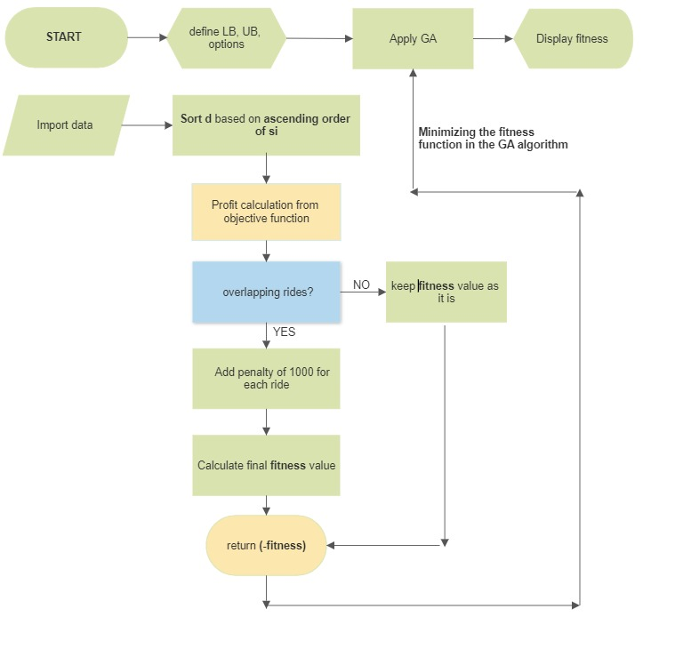
Flow chart

Slide 12
Example
Consider 4 pre-booked rides and 3 vehicles and all the cars are at position (0,0) initially. Consider a velocity matrix for all the vehicles given by v = [1 0.5 1]. We run the program using GA metaheuristic technique with maximum of 500 iterations and ‘MaxStallGenerations’ of 100.
The below table shows start time, end-time, start destination and end destination for all the rides.
Rides | Vehicle time taken |  |  | Start time | End time | Start point |  | End point
 | C1 | C2 | C3 |  |  | X1 | Y1 | X2 | Y2
1 | 4 | 8 | 4 | 2 | 10 | 0 | 1 | 2 | 3
2 | 5 | 10 | 5 | 12 | 20 | 1 | 4 | 2 | 0
3 | 3 | 6 | 3 | 5 | 12 | 0 | 0 | 1 | 2
4 | 2 | 4 | 2 | 12 | 18 | 0 | 1 | 0 | 0

Slide 13
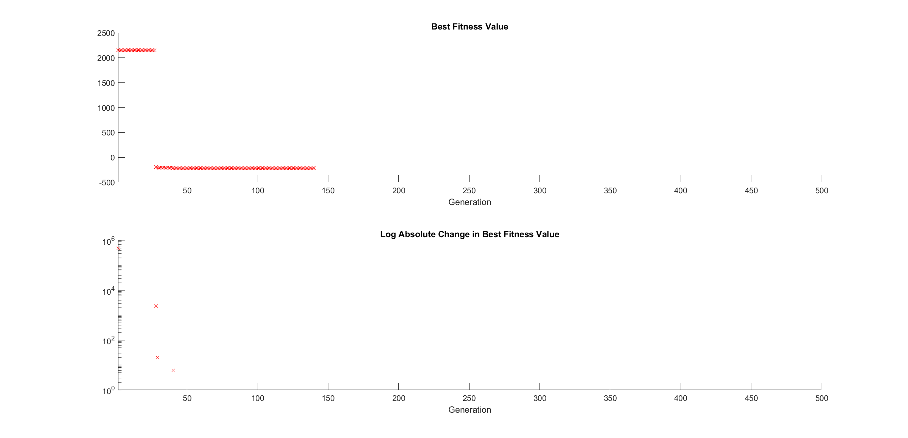
Plots
Figure 1: shows best fitness value over the generations (Graph 1)
and log of absolute change in best fitness value over generations (Graph 2)

Slide 14
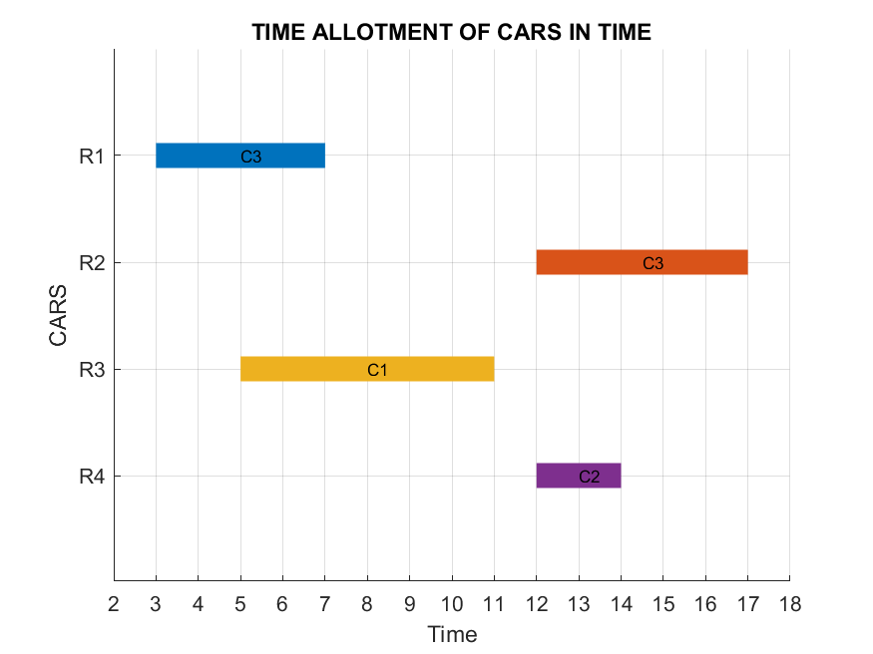
Plots
Figure 2: shows the final vehicle and its time allotment to the rides

Slide 15
The results obtained in our first example are given in the figure 1 & 2.
They show that after a certain number of iterations in GA, we get the maximum profit made by all the ride as 216 points. In this way we can easily automate the process of scheduling pre-booked rides and assign the vehicles.
For verifying the working of our algorithm we have taken another set of data points in Table-2. There we have taken the velocity matrix as v = [1 0.5 1 1 0.2]. Then again we have run our program and calculated the results as earlier in figure-3 & 4.
Rides | Vehicle time taken |  |  |  |  | Start time | End time | Start point |  | End point
 | C1 | C2 | C3 | C4 | C5 |  |  | X1 | Y1 | X2 | Y2
1 | 3 | 6 | 3 | 3 | 15 | 1 | 5 | 0 | 4 | 2 | 3
2 | 2 | 4 | 2 | 2 | 10 | 2 | 5 | 3 | 1 | 4 | 0
3 | 3 | 6 | 3 | 3 | 15 | 5 | 9 | 0 | 0 | 1 | 2
4 | 6 | 12 | 6 | 6 | 30 | 4 | 12 | 2 | 4 | 0 | 0
5 | 3 | 6 | 3 | 3 | 15 | 10 | 14 | 1 | 1 | 3 | 2
6 | 4 | 8 | 4 | 4 | 20 | 13 | 18 | 3 | 2 | 1 | 4
7 | 3 | 6 | 3 | 3 | 15 | 17 | 22 | 1 | 3 | 3 | 4

Slide 16
Plots
Figure 3: shows best fitness value over the generations (Graph 1)
and log of absolute change in best fitness value over generations (Graph 2)

Slide 17
Plots
Figure 4: shows the final vehicle and its time allotment to the rides

Slide 18
Optimization of the scheduling problem using metaheuristic technique like GA provides us a rich experience for the constrained combinatorial optimization problems. We successfully assigned available vehicles to N rides and generated maximum profit in the problem. Although GA takes plenty of time to provide a good result, it provides a flexible framework for evolutionary computation and it can handle varieties of objective function and constraint.
Conclusion

Slide 19

Video Presentation
Link to video presentation

Slide 20
THANK YOU

